Slide 1

CH 42010: PROCESS PLANT OPERATION & SAFETY
LTP: 3-0-0, CRD: 3
Lecture 5
Emergency Response Strategy for Plants

Slide 2
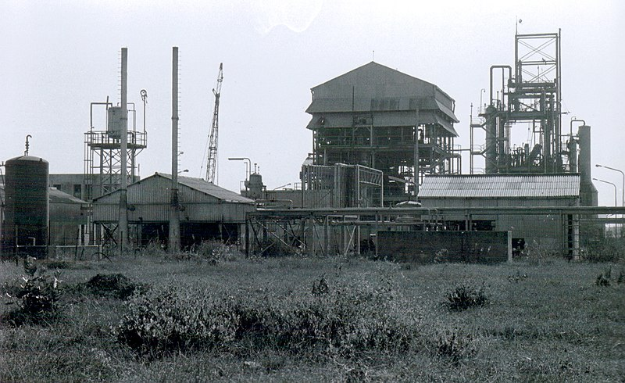
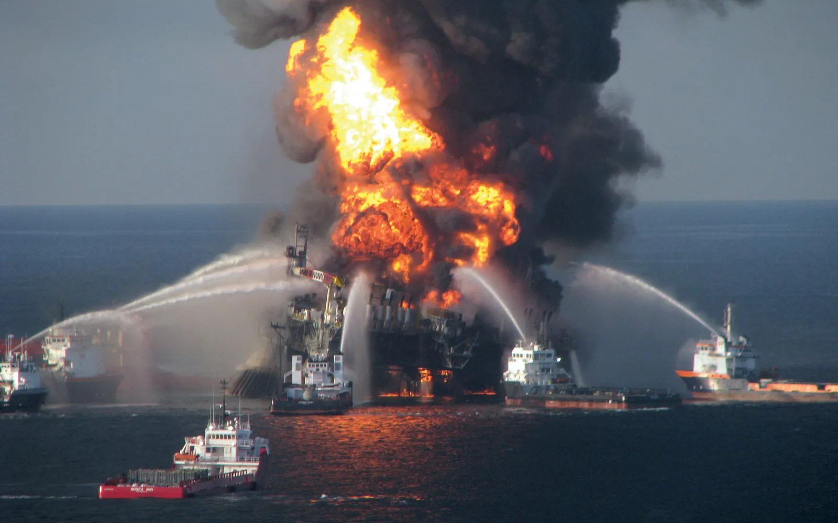
INTRODUCTION TO EMERGENCY SITUATIONS
Types of emergencies that can arise in industrial settings: Fires, Explosions, Chemical spills, Gas leaks, and Power failures
Bhopal Gas Tragedy
Deepwater Horizon Oil Spill
EMERGENCY RESPONSE PLANNING (ERP)
Source: Google Images

Slide 3
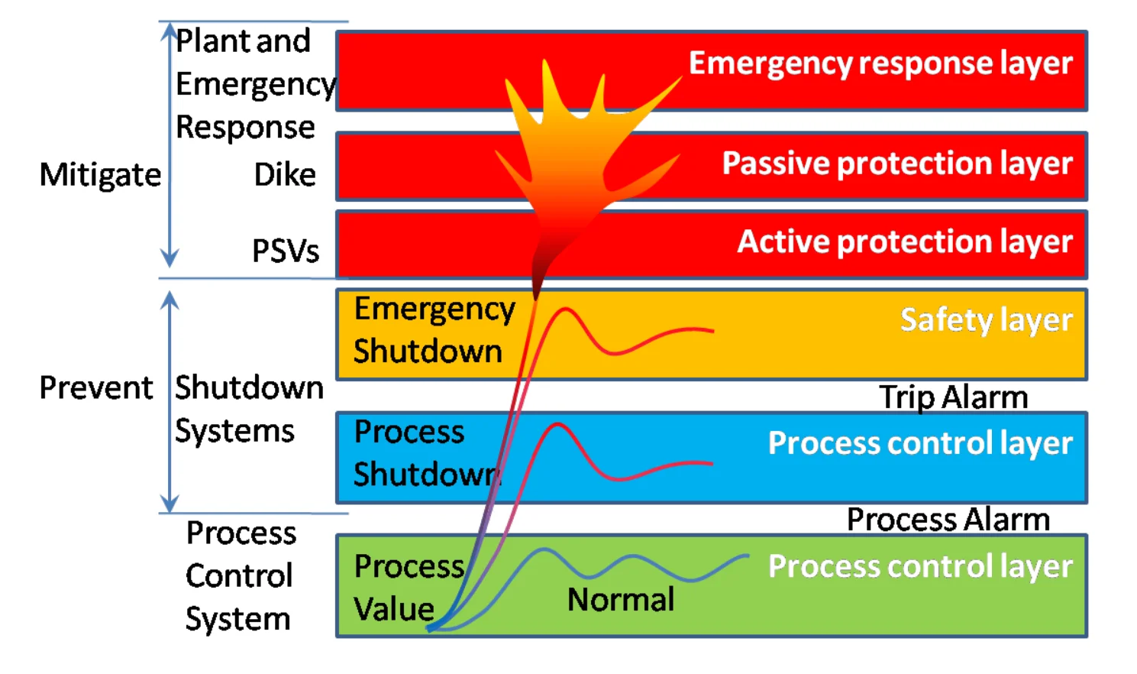

EMERGENCY SHUTDOWN PROCEDURES (ESP)
Source: Google Images
Cooling
Pumping out
Residuals removal
Blinding and opening
Inspection for entering
ESP
Dikes or Containment systems: Type of protection layer used to prevent the release of hazardous materials in the event of a spill or leak
PSV – Pressure Safety Valve
The Last Line of Defence

Slide 4
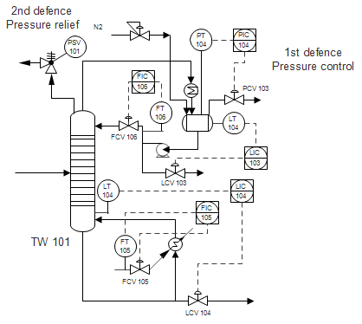
EMERGENCY SHUTDOWN PROCEDURES (ESP)
PSV – Pressure Safety Valve & RV – Relief Valve
Overpressure of a chemical process plant may lead to major hazard (fire, explosion and toxic release)
The 1st line of defense against overpressure hazard is good pressure control: PCV – Controlling the process pressure within safe operating pressure region
The 2nd line of defense against overpressure hazard is to install PSV/RV to relief liquid or gases before excessive pressures are developed
RV | PSV
Primarily for liquid service | Steam, gas & vapor service
RV should open at the set pressure (normally less than 10% of operating P) and reaches full capacity at 25% overpressure. RV closes as the system pressure returns to the set pressure. | PSV should open at the set pressure and reseat after reaching approximately 4% below set P.
Source: Google Images

Slide 5
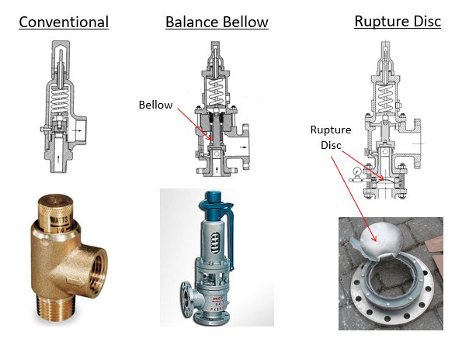
EMERGENCY SHUTDOWN PROCEDURES (ESP)
PSV – Pressure Safety Valve & RV – Relief Valve
Guidelines where RVs should be installed:
All vessels need reliefs, including reactors, storage tanks, towers and drums.
Blocked-in sections of cool liquid-filled lines which are exposed to heat (e.g., cooling water side of a heat exchanger) or refrigeration need reliefs.
Positive displacement pumps, compressors and turbines need reliefs on the discharge side.
Vessel steam jackets are often rated for low pressure steam. Reliefs are installed in jackets to prevent excessive steam pressures due to operator error or pressure regulator failure.
Storage vessels need pressure and vacuum reliefs to protect against pumping in or out of a blocked-in vessel or against the generation of a vacuum by condensation.
All reliefs devices should be inspected for their functionality and set pressure during shut-down.
Source: Google Images
Spring operated PSV/RV which can be used repeatedly:
Conventional.
Balanced Bellow: eliminating the back pressure effect when the device activates and avoid direct contact of corrosive media with spring etc.
Rupture Disc: A calibrated sheet of metal designed to rupture at a specified pressure. Can be used one time only.

Slide 6
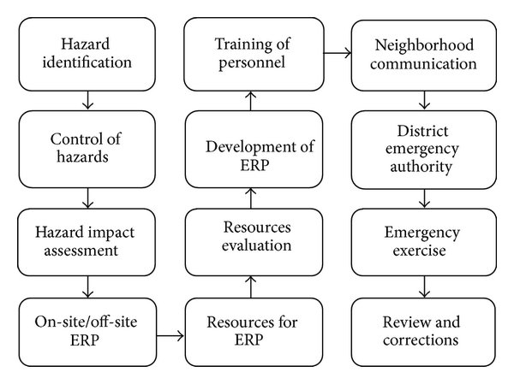
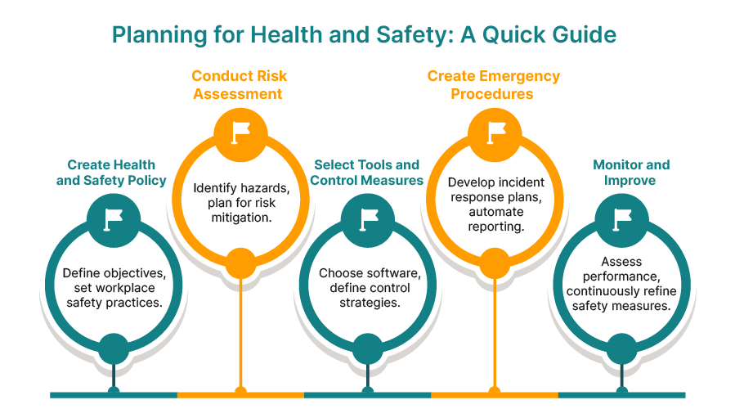
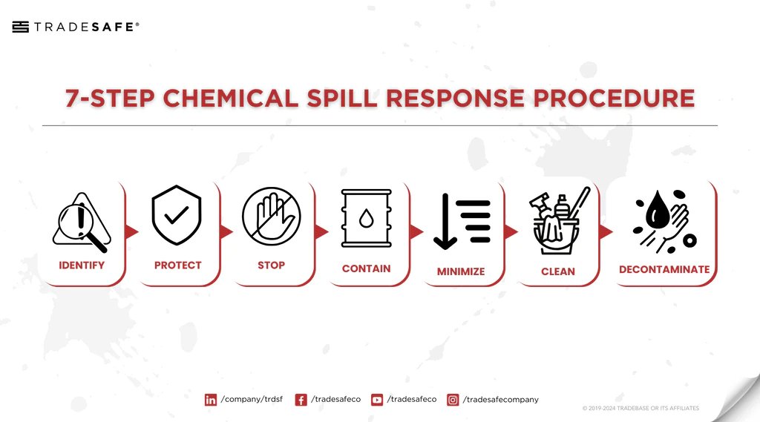
EMERGENCY RESPONSE PLANNING (ERP)
FMEA
HAZOP
FTA
Plant-specific emergency procedures and emergency shutdown processes for critical equipment
Importance of proper signage, alarms, and emergency lighting
Evacuation procedures and Communication protocols
Source: Google Images

Slide 7
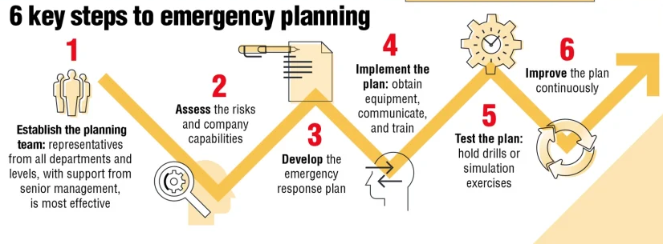
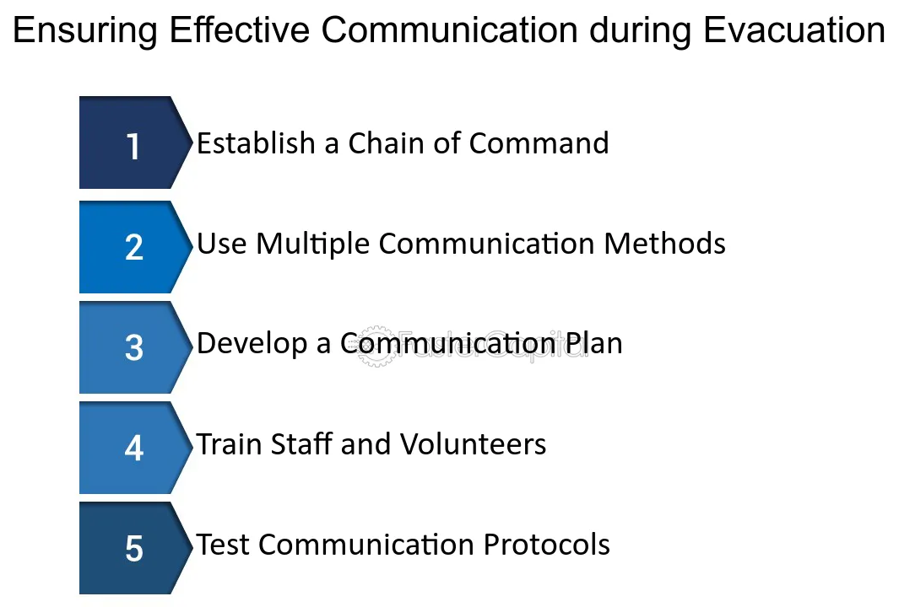
EMERGENCY RESPONSE PLANNING (ERP)
Governmental Rules & Regulations (Govt. of India)
Factory Acts & Rules
Boiler Act 1923
State Boiler Rules
Indian Boiler Regulations 1950
The Petroleum Act & Rules
The Explosive Act & Rules
The Insecticide Act & Rules
The Poisonous Acts & Rules
The Electricity Act & Rules
Gas Cylinder Rules 1981
Static & Mobile Pressure Vessels 1981
Water & Air Pollution Control Acts & Rules
Environment Protection Act 1986 & Rules
Hazardous Waste Management Rules 1989
MSIHC Rules 1989
Chemical Accident Rules 1996
Bio Medical Waste Rules 1998
Building & Construction Act 1996.
Radiation protection Rules
Atomic Agency Act
Source: Google Images

Slide 8
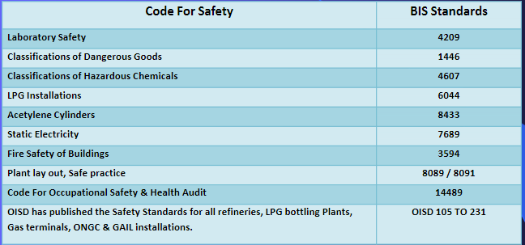
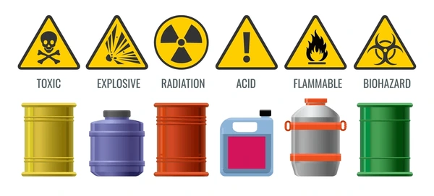
EMERGENCY RESPONSE PLANNING (ERP)
Governmental Rules & Regulations (Govt. of India)
BIS Standards
Oil Industry Safety Directorate (OISD) – Ministry of Petroleum and Natural Gas
Source: Google Images

Slide 9
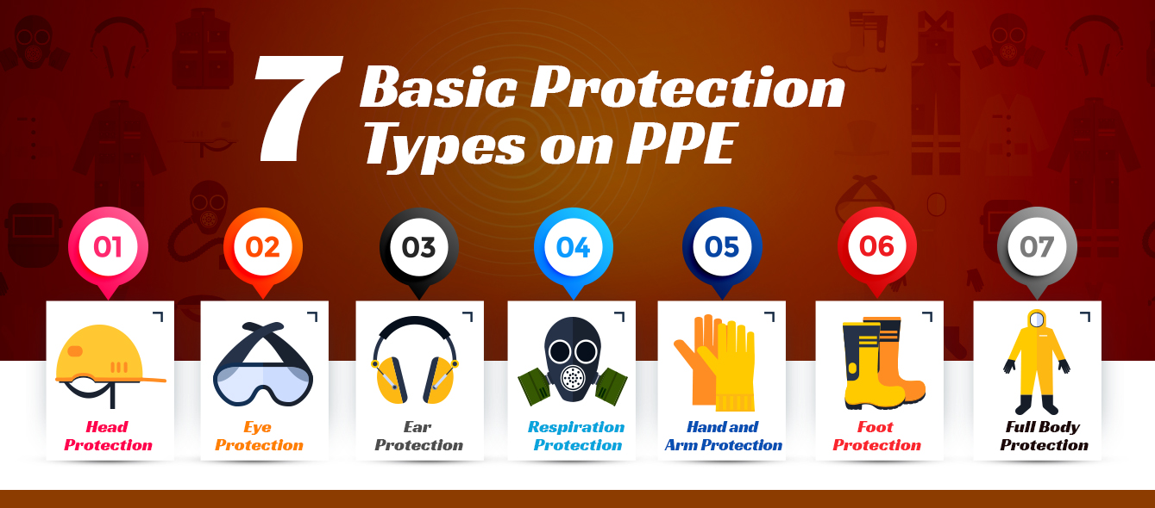
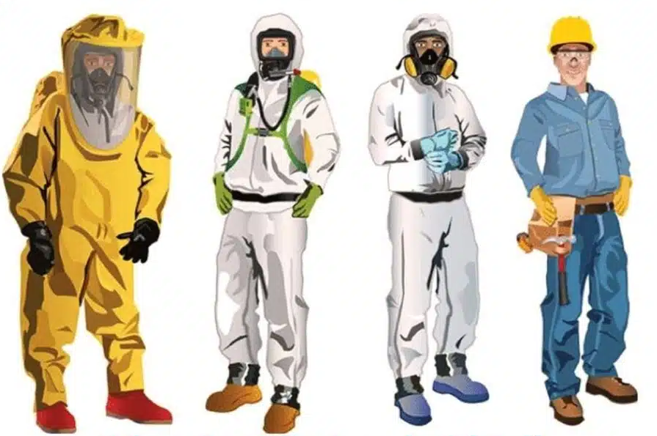
PERSONAL SAFETY
Protective Equipments (PPE) - fire-resistant clothing, breathing apparatus, and chemical-resistant gloves.
Source: Google Images
Level A
Level B
Level C
Level D
https://www.osha.gov/sites/default/files/publications/osha3151.pdf
American National Standards Institute (ANSI)
Occupational Safety and Hazard Administration (OSHA) requires PPE to meet the following ANSI standards
Eye and Face Protection: ANSI Z87.1-2010, ANSI Z87.1-2003, or ANSI Z87.1-1989(R1998).
Head Protection: ANSI Z89.1-2009, ANSI Z89.1-2003, or ANSI Z89.1-1997.
Foot Protection: ASTMF-2412-2005 and ASTMF-2413-2005, ANSI Z41-1999, or ANSI Z41-1991.
Electrical Rubber Insulating Equipment: ASTM D120-09, ASTM D-178-01 (2010), ASTM D-1048-12, ASTM D-1049-98 (2010), ASTM D-1050-05 (2011), or ASTM D1051-08.

Slide 10
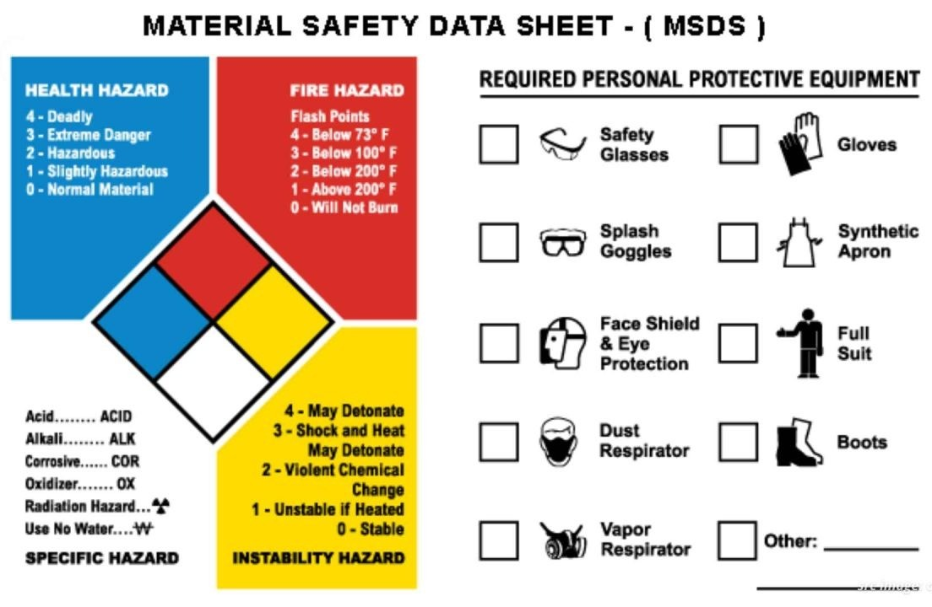
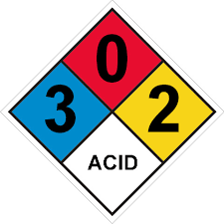
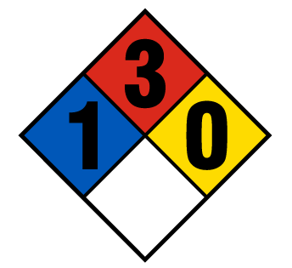
PERSONAL SAFETY
Sulfuric Acid (Conc.)
Methanol
Source: Google Images

Slide 11
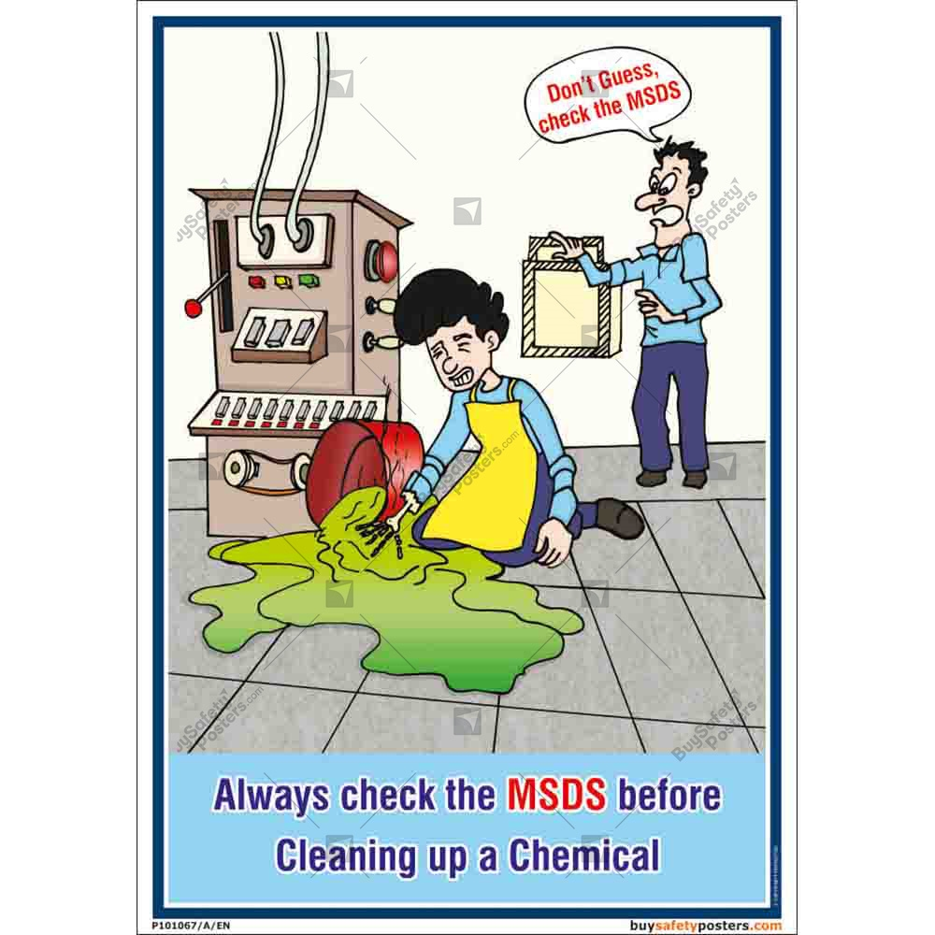
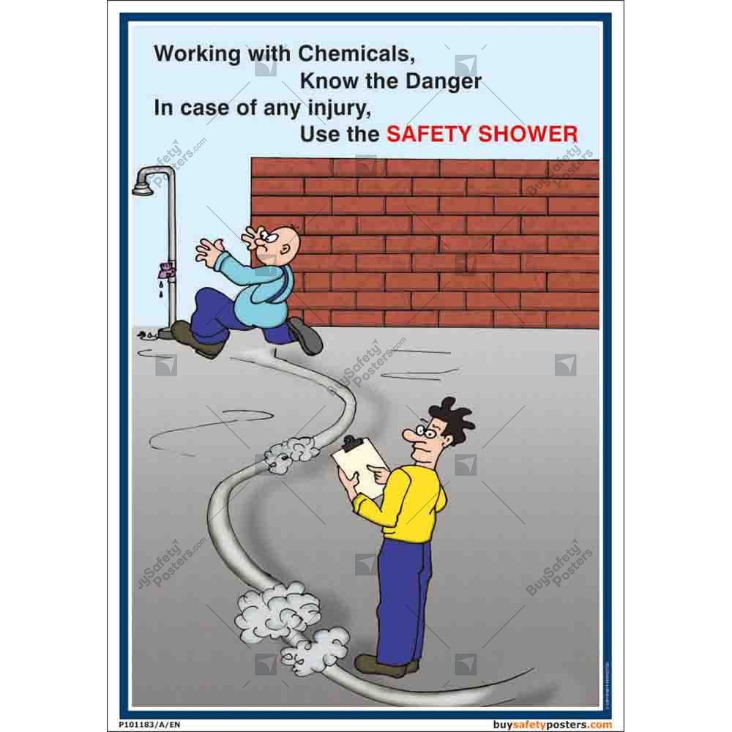
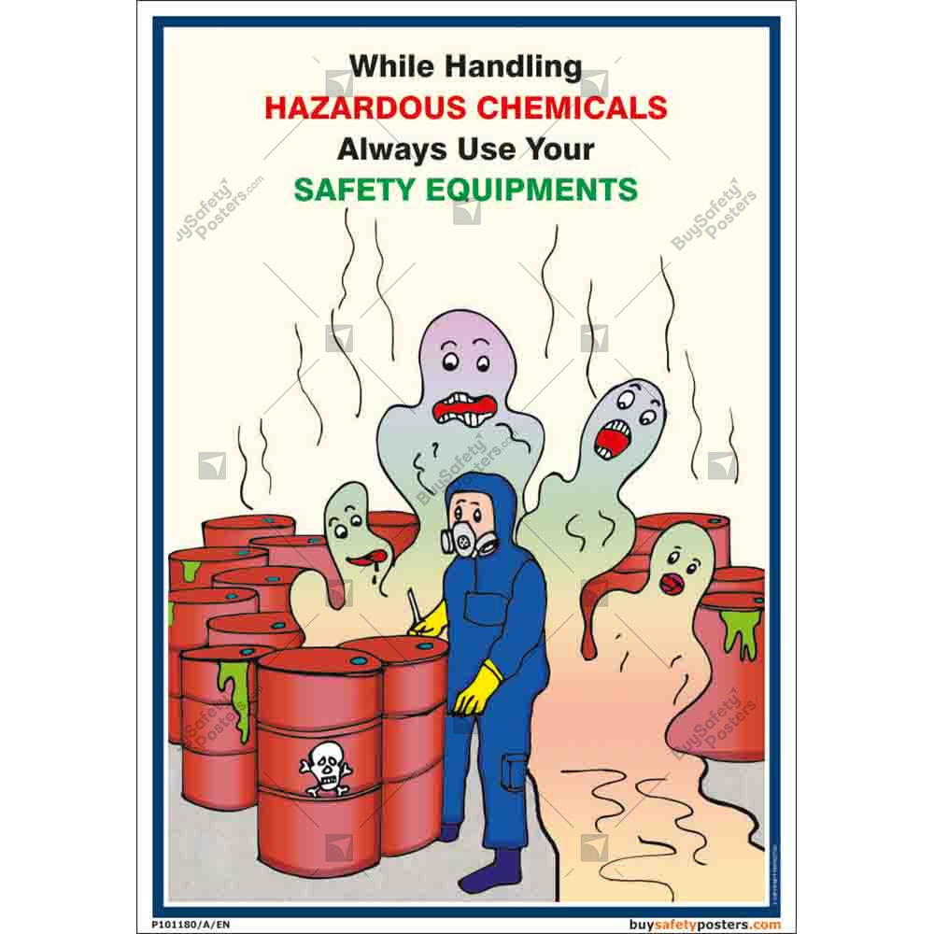
PERSONAL SAFETY
Source: Google Images

Slide 12
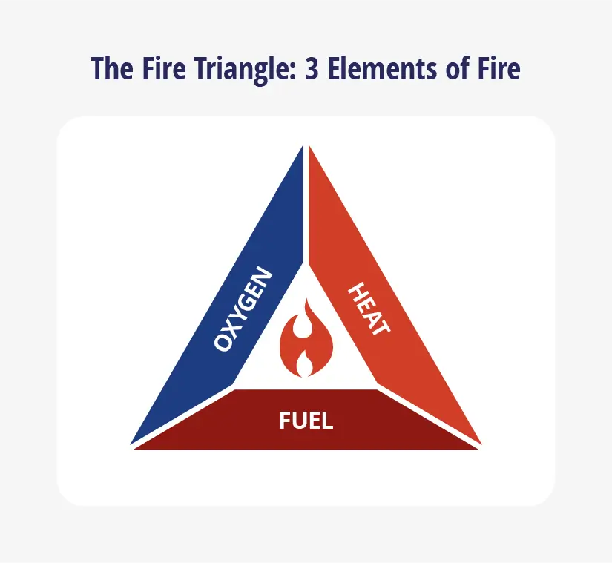
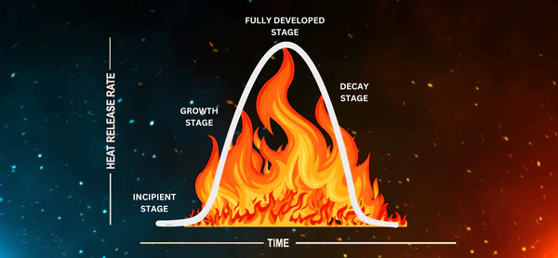
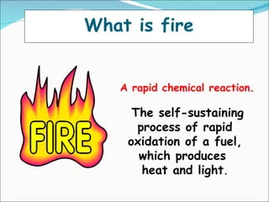
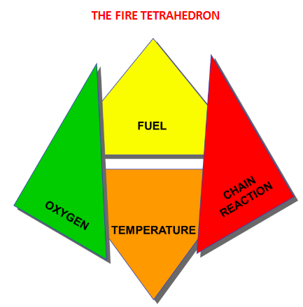
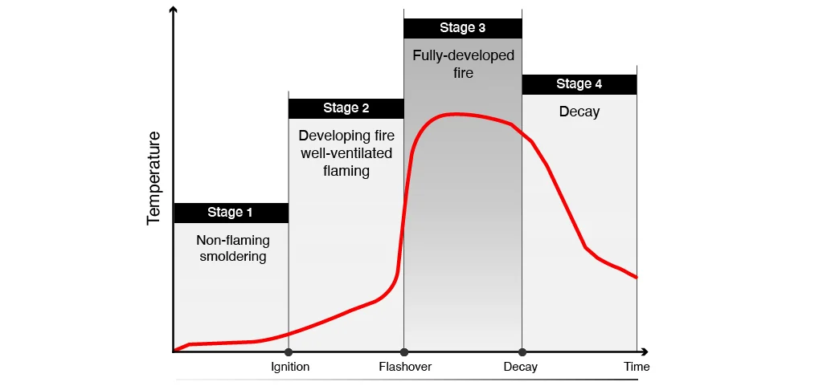
FIRE SAFETY
Fire Tetrahedron
Stages of Fire
Source: Google Images

Slide 13
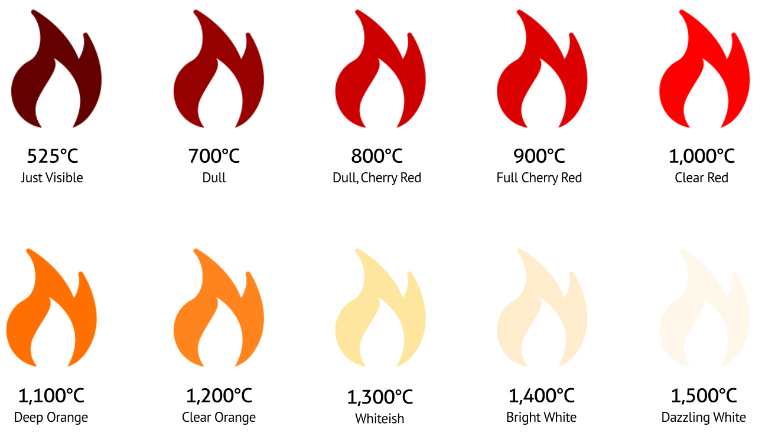
FIRE SAFETY
The Temperature of Fire
Source: Google Images

Slide 14
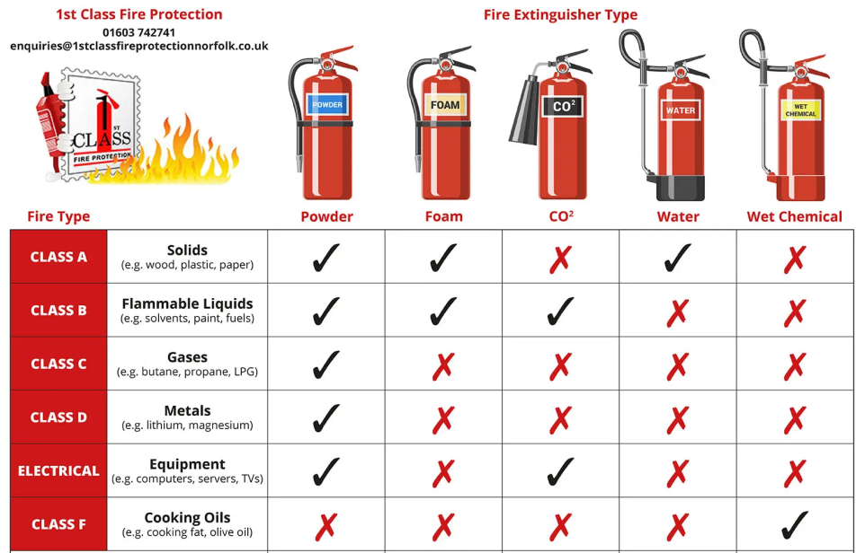
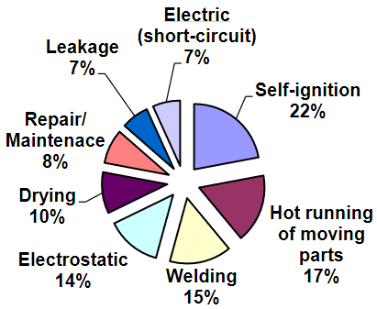
FIRE SAFETY AND PREVENTION
CAUSES OF FIRE IN A CHEMICAL PLANT
Source: Google Images

Slide 15
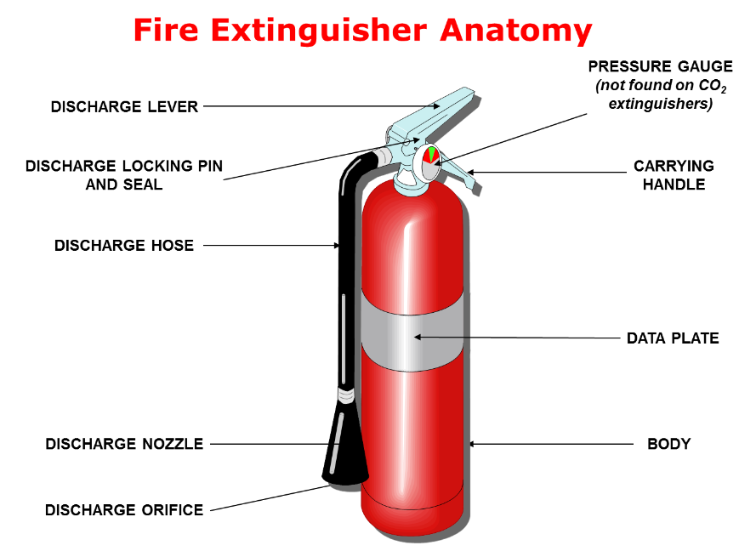
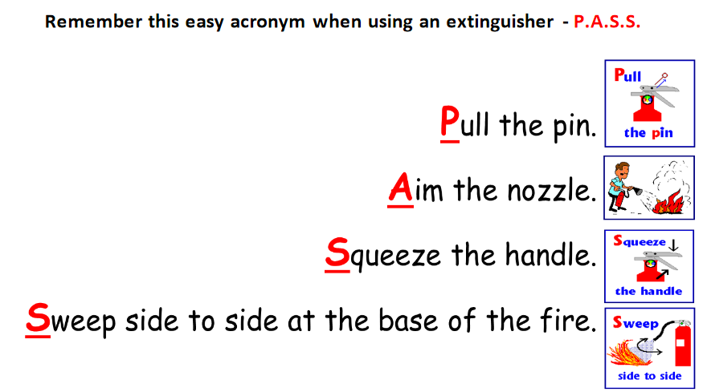
FIRE SAFETY AND PREVENTION
Remember this acronym when using an extinguisher – P. A. S. S.
Source: Google Images

Slide 16
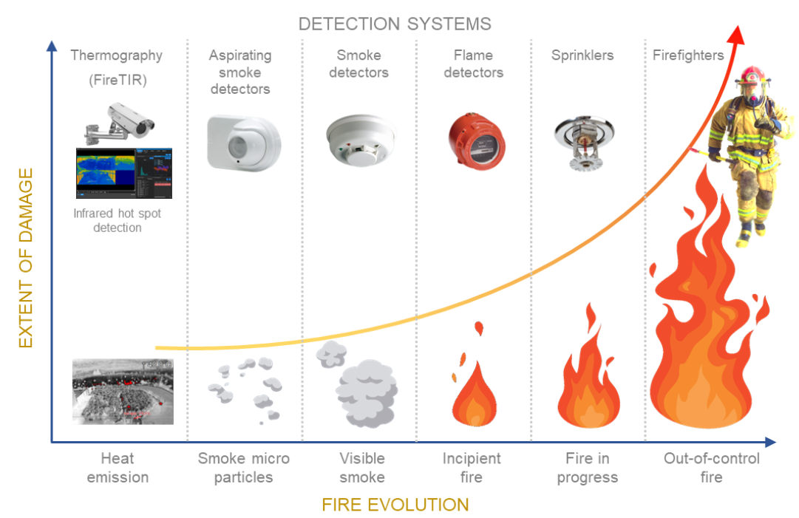
FIRE SAFETY AND PREVENTION
Source: Google Images

Slide 17
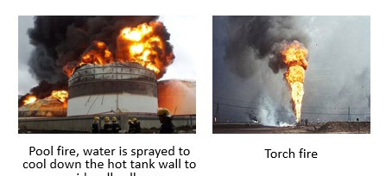
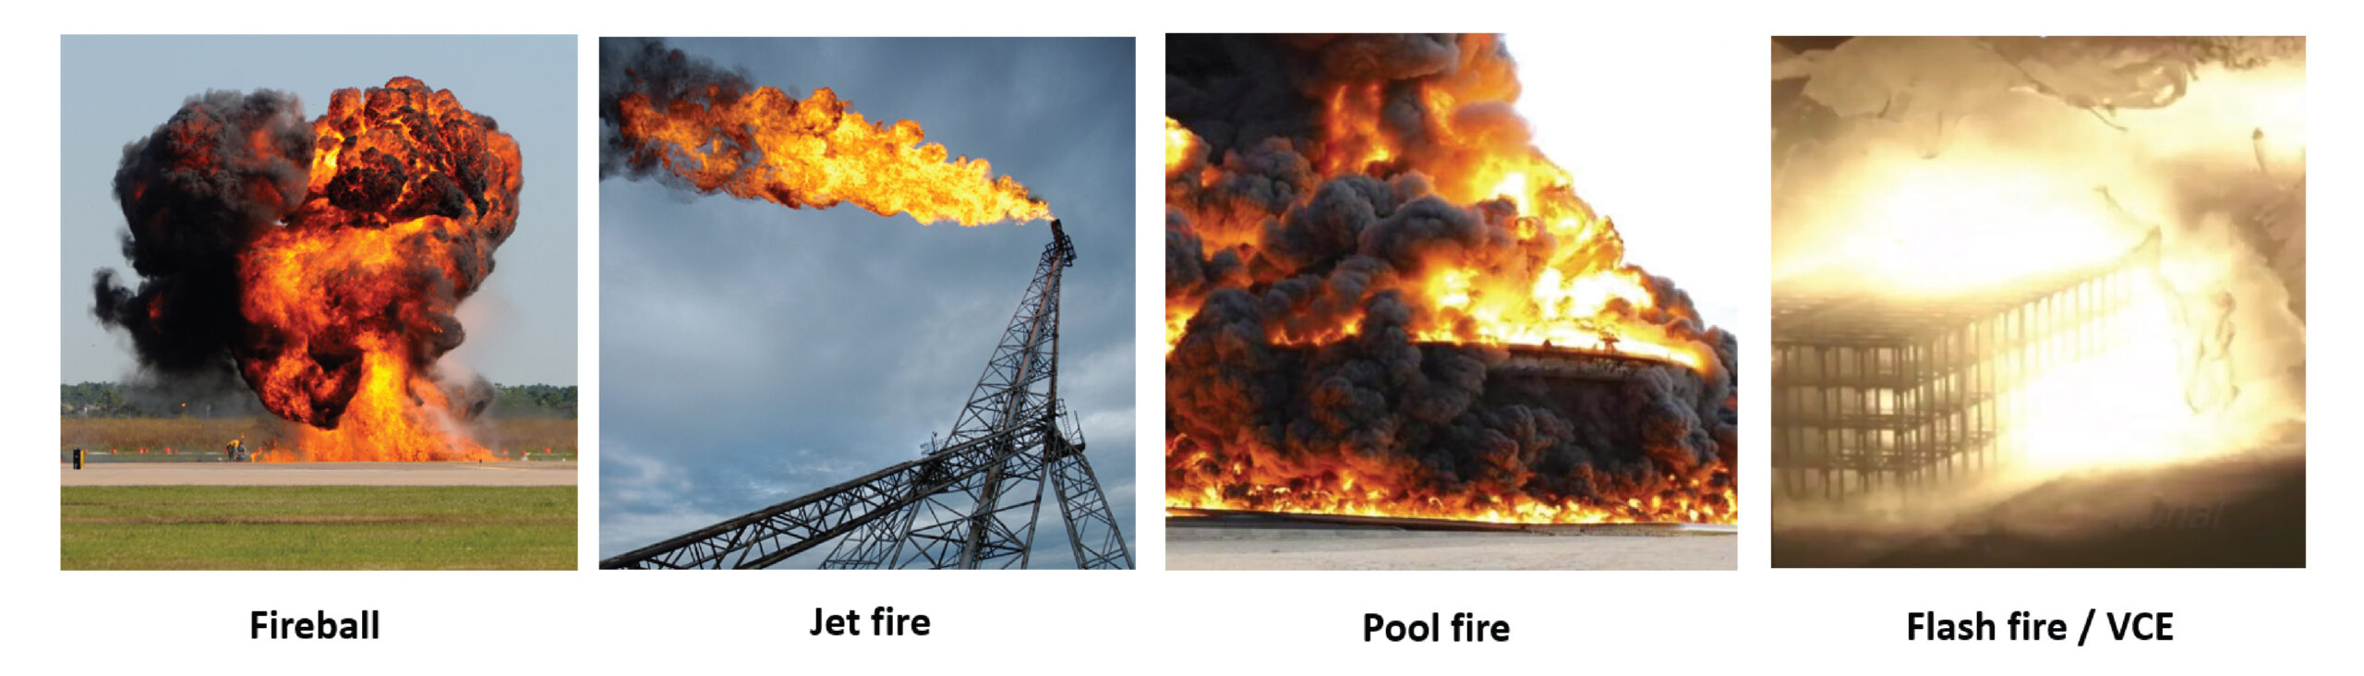
FIRE SAFETY AND PREVENTION
Pool Fire
Liquid spills onto the ground forming a pool. The volatile liquid (example: petrol) evaporates into atmosphere to form flammable mixture, ignited and form pool fire. The heat vaporizes more fuel and air is drawn in round to the side to support combustion. Danger to people is by direct thermal radiation.
Flash Fire
Relatively volatile spilled material (example: propane, butane, LPG) forms a pool with rapid evaporation forming sizeable vapor cloud, drifted away by wind, ignited by ignition source to form flash fire. People is at risk from thermal radiation effect.
Torch Fire
High pressure release of gas from a pressure vessel or pipeline ignites almost immediately, forming torch fire with flame length tens of meters. Danger arises from thermal radiation and also impingement on adjacent pressurized vessel containing liquefied petroleum gas (LPG) may cause vessel failure from boiling liquid expansion vapor explosion (BLEVE).
Source: Google Images

Slide 18
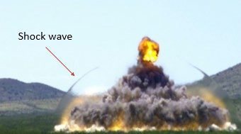
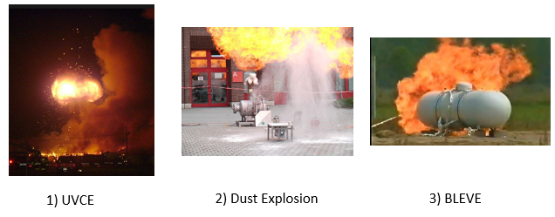
FIRE SAFETY AND PREVENTION
Explosion is sudden and violent release of energy physically or chemically. Examples of chemical explosion are explosion from explosive material and exothermic chemical reaction.
Examples of physical explosion are explosion due to fracture of a vessel containing high pressure gas or steam due to over pressure.
In general, explosion can be divided into two types:
Deflagration: resulting shock wave moving at the speed less than speed of sound (Mach Number < 1).
Detonation: resulting shock wave moving at the speed greater than speed of sound (Mach Number > 1), i.e., shock wave followed closely by a combustion wave.
Source: Google Images
Source: Google Images

Slide 19
FIRE SAFETY AND PREVENTION
Confined Vapor Cloud Explosion (CVCE)
Vapor explosion occurs within a vessel or building.
Popular example: Abbeystead disaster, 1984, in which methane gas in water pumping station ignited killing several visitors.
Unconfined Vapor Cloud Explosion (UVCE)
It is an explosion due to the ignition of large pre-mixed cloud of flammable vapor and air of concentration within the flammable range.
Popular example:
Flixborough, 1974 in which a major leak of hydrocarbon occurred at a reactor non-standard modified piping, forming vapor cloud, ignited and led to UVCE.
Boiling Liquid Expanding Vapor Explosion (BLEVE)
Vessel containing flammable liquid (e.g., LPG) is heated by fire from neighbouring vessel. The flammable liquid vaporized and build pressure, vessel weakened and finally ruptures creating vapor cloud and explodes. Casualties are from blast effect, thermal radiation or missiles.
Popular example: Feyzin 1966 involving propane tank and San Juanico, Mexico City 1984 involving LPG tank.
Dust Explosion (DE)
Results from the rapid combustion of fine combustible solid particles (dust in grain silo, iron & aluminum dust).
Popular example: New Orleans in 1977 in which 45 silos containing corn, wheat and soy beans were involved.

Slide 20
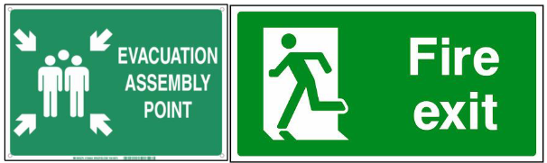
EVACUATION PROCEDURES
EMERGENCY EVACUATION
Emergency evacuation is the urgent immediate egress or escape of people away from an area that contains an imminent threat, an ongoing threat or a hazard to lives or property.
In situations involving hazardous materials or possible contamination, evacuees may be decontaminated prior to being transported out of the contaminated area.
Evacuation Sequence:
Detection
Decision
Alarm
Reaction
Movement to an area of refuge or an assembly station
Transportation
The time for the first four phases is usually called pre-movement time.
The most common equipment to facilitate emergency evacuations are fire alarms, exit signs, and emergency lights. Some structures need special emergency exits or fire escapes to ensure the availability of alternative escape paths.
Source: Google Images

Slide 21

POST-EMERGENCY PROCEDURES & INCIDENT INVESTIGATION
RCA
Source: Google Images

